Slide 1





Slide 2


DATA ANALYSIS PROJECT FOR ZOMATO
BY: TASNEEM KHACHRODWALA

Slide 3


TOPICS COVERED
COUNTRIES FOR OPENING NEW RESTAURANTS
COUNTRY-WISE AVERAGE RATINGS
CURRENT FOOD EXPENDITURE
TOP CUISINES
TABLE BOOKING & ONLIINE DELIVERY
REPORTING DASHBOARD

Slide 4





Best countries to open new restaurants
The selection of countries for new restaurants is based on various factors, including the count of existing restaurants, average order value, and average ratings. Let's analyze the data:
Top Performers/ Potential Growth Markets:
  Singapore: High average order value and decent average ratings.
  United Kingdom: Moderate average order value but high average ratings.
  United Arab Emirates: Moderate average order value and high average ratings.
  Qatar, New Zealand: These countries have a reasonable number of restaurants and good average order values, making them potential growth markets.

Slide 5

          RATINGS
Quality Analysis by Ratings
          - Outstanding quality, high customer satisfaction, and market appeal.
- Positive dining experiences, culinary excellence, and growth potential.
- Diverse cuisines & potential for upscale dining.

Slide 6

AVERAGE FOOD EXPENDITURE IN COUNTRIES SELECTED
COUNTRY EXPENDITURE
New Zealand $43
Qatar $60
Singapore $117
UAE $45
UK $61
Key Takeaway:
Leveraging expenditure data is vital for strategic decision-making, ensuring the business aligns with local market conditions, enhances financial control, and optimizes customer satisfaction.

Slide 7
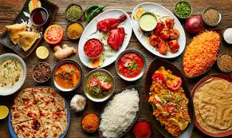
TOP CUISINES
Chinese
Italian
Thai
Indian
Indian
Continental
North Indian
American, Desserts
American, Burger, Grill
Taiwanese,
Steak
Chinese, Dim Sum
QATAR
UAE
UK
Bakery
Italian
American, Steak
Chinese, Seafood,
Dim Sum
Desserts
Ice Cream, Desserts
Cafe, American
Italian
SINGAPORE
NEW ZEALAND

Slide 8


TABLE BOOKING AND ONLINE DELIVERY SERVICES
Considering these services in our new projects will trigger-
Market Differentiation: Launching online services in key markets.
Customer Convenience: Simplifying dining with digital access.
Revenue Opportunities: Exploring new online revenue channels.
Operational Efficiency: Streamlining management and peak capacity.
Trend Adaptation: Aligning with evolving consumer and tech trends.
TABLE BOOKING
ONLINE DELIVERY

Slide 9

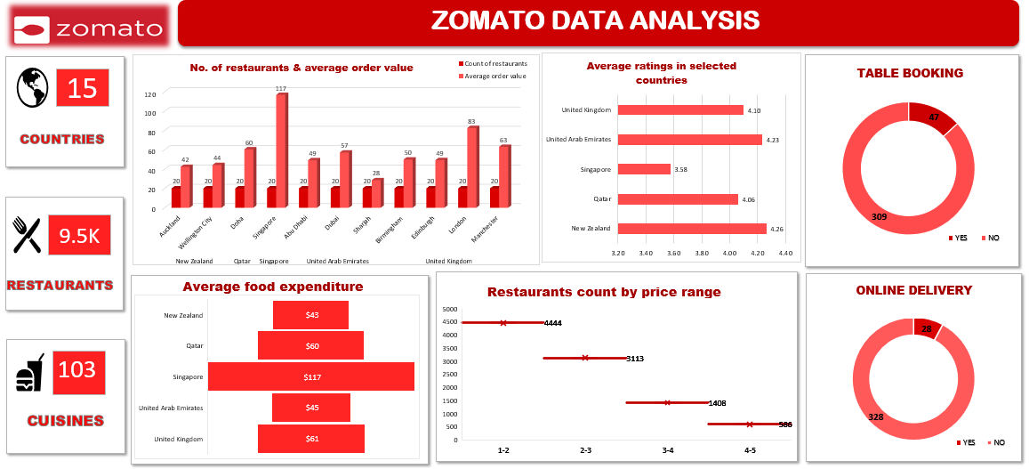


REPORTING DASHBOARD

Slide 10


